Slide 1
Term 2 Week 10 Lesson 1
The importance of bonding

Slide 2
Bonding is responsible for many of the properties of materials and biomolecules. The nucleic acids in the DNA double helix are held together by hydrogen bonds.
Hydrogen bonding helps maintain the structures of proteins, enzymes, ribosomes and cell membranes.
Analytical techniques such as chromatography work because of surface interactions and the intermolecular bonds of different substances to different surfaces or solvents. This knowledge allows chemists to determine the organic substances in mixtures.

Slide 3
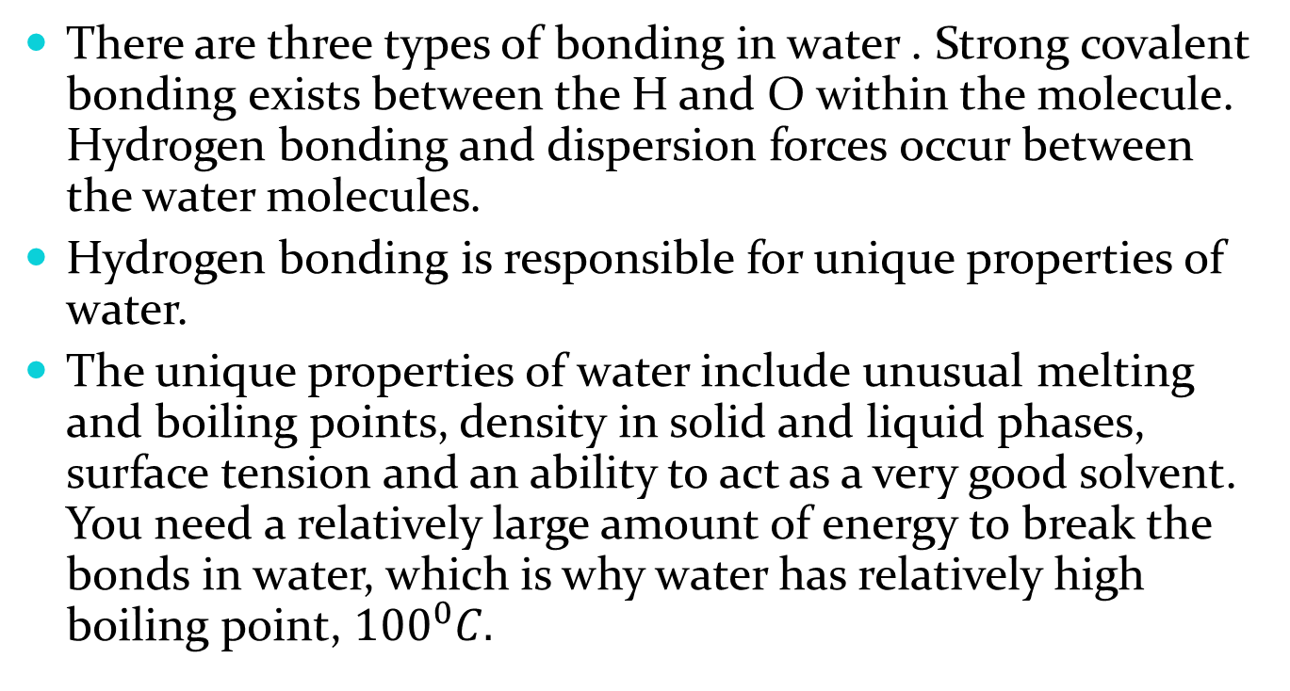
Water and hydrogen bonding
There are three types of bonding in water . Strong covalent bonding exists between the H and O within the molecule. Hydrogen bonding and dispersion forces occur between the water molecules.
Hydrogen bonding is responsible for unique properties of water.
The unique properties of water include unusual melting and boiling points, density in solid and liquid phases, surface tension and an ability to act as a very good solvent. You need a relatively large amount of energy to break the bonds in water, which is why water has relatively high boiling point, ${100}^{0}C.$

Slide 4
For a certain amount of energy, fewer molecules escape into the air. The fewer vaporised water molecules means lower vapour pressure, the downwards pressure exerted by the gas molecules on the surface of the liquid.
To change state from liquid to gas or to increase the average temperature of the water, energy must be absorbed. The change is endothermic.

Slide 5
The high surface tension of water is a result of its strong intermolecular forces. At the water surface there is an imbalance of these forces causing surface molecules to be pulled inwards towards the bulk of the liquid. As a consequence the surface is trying to contract and achieve a minimum area. This is why free falling or suspended drops of water try to achieve a spherical shape. This shape has the smallest possible surface to volume ratio.

Slide 6
Surface tension is the elastic tendency of liquids which makes them acquire the least surface area possible.
Surface tension of water is high due to the strong hydrogen bonding acting in all directions. This holds the molecules together.
Cohesion- The intermolecular attraction that holds molecules and masses together.
Cohesive nature of water helps plants to absorb nutrients from the soil.

Slide 7
Adhesion is the tendency of dissimilar particles or surfaces to cling to one another .
The water move up the xylem of the plant to the leaf surface by capillary action. Capillary action depends on the adhesion of water molecules to the sides of the xylem vessel and the cohesive properties of water. Through cohesion of water molecules dissolved nutrients are pulled all the way up all the trees, against gravity.

Slide 8
Capillary action
This is due to three main forces.
Cohesive force- The intermolecular force between molecules in a substance which can maintain a certain shape of the liquid.
Surface tension- Due to cohesive forces at the surface and results in surface of the fluid being under tension.
Adhesive force- Forces of attraction between unlike molecules.
Example of capillary action: Narrow glass vessels – The surface of water to curve to form a meniscus due to adhesive forces between water molecules and the surface of the glass and the cohesive forces in water.

Slide 9
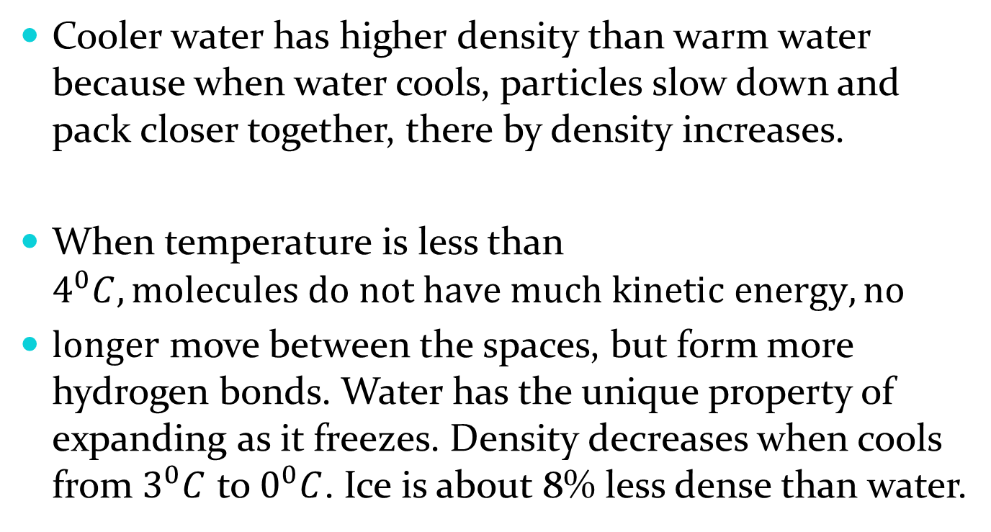
Cooler water has higher density than warm water because when water cools, particles slow down and pack closer together, there by density increases.
When temperature is less than $4^{0}C, molecules do not have much kinetic energy, no$
$longer$ move between the spaces, but form more hydrogen bonds. Water has the unique property of expanding as it freezes. Density decreases when cools from $3^{0}C$ to $0^{0}C$. Ice is about 8% less dense than water.

Slide 10
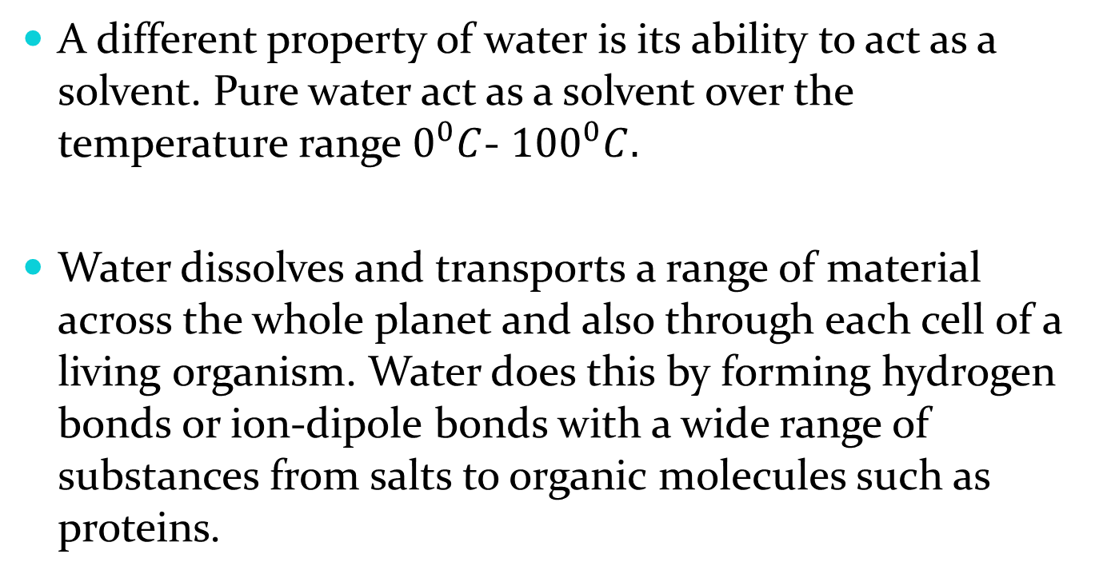
A different property of water is its ability to act as a solvent. Pure water act as a solvent over the temperature range $0^{0}C$- ${100}^{0}C.$
Water dissolves and transports a range of material across the whole planet and also through each cell of a living organism. Water does this by forming hydrogen bonds or ion-dipole bonds with a wide range of substances from salts to organic molecules such as proteins.

Slide 11
Water of crystallisation
Water of crystallisation occurs when water molecules are attracted to the ions of a salt. Many ionic compound that crystallise out of an aqueous solution include water molecules in a regular array through the crystal lattice.
These compounds are known as hydrated.
E.g. CuSO4. 5H2O – has 5 water molecules of crystallisation per unit of copper(II) sulfate. The bonds between the ions and water are called ion-dipole bonds. In water molecules it form a weak bond.

Slide 12
Water or other molecules form dipole bonds to a metal atom are referred to as ligands.
The water of crystallisation in a hydrated compound can be evaporated by heating. The compound is said to be anhydrous when all molecules have been removed.
Complete the following questions from page: 131 EC
Set 25: 1(b) and (g), 3, 7 and 9

